Slide 1
User interface applications
VUT
Carlos Soriano
Notes:
Hello everybody, my name is.... Working as maintainer of Nautilus (show nautilus)
This lesson is going to talk about user interfaces and applications, we will learn how to create a UI, what are the right tools for you, and finally we will live code an application.
I would like to make this presentation as dynamic as possible, so I bring some beers openers and stickers for those who give great questions or answers. Also I know I have an accent.... Can you guess from where I am? Anyway, you have two hours to get used to my accent, but please feel free to ask right away if you have any doubt or want me to repeat an explanation or sentence, the goal here is to be useful to you.

Slide 2
Overview
Q&A we will know
Brief history
State of the art
Principles
Gtk
Our first examples
Our own GUI app
Conclusions
Repeat Q&A

Slide 3
Q&A we will know
What’s a GUI and why do we need it?
How can we do our own GUI app?
What resources can the toolkit offer us?
How can we make a good GUI, design wise?
How can we decide what are the right tool for me?
Where can we have further resources and help?
Notes:
Point out the difference between “How can I decide what are the right tool” != “What are the right tool for me”. We don’t want to know what tools are appropriate, but teach how we can decide for ourselves. Thread safety? Embedded systems? Portability? Cross platform? Resources consumption? Soft and hard real time? Critical software (mention aircraft controllers and whole US military using RHEL)?

Slide 4
Brief history
We can just write, but...
Humans are used to interact with objects
Computer objects must have similarities to reality
Humans prefer simplicity
Humans prefer clearness

Slide 5
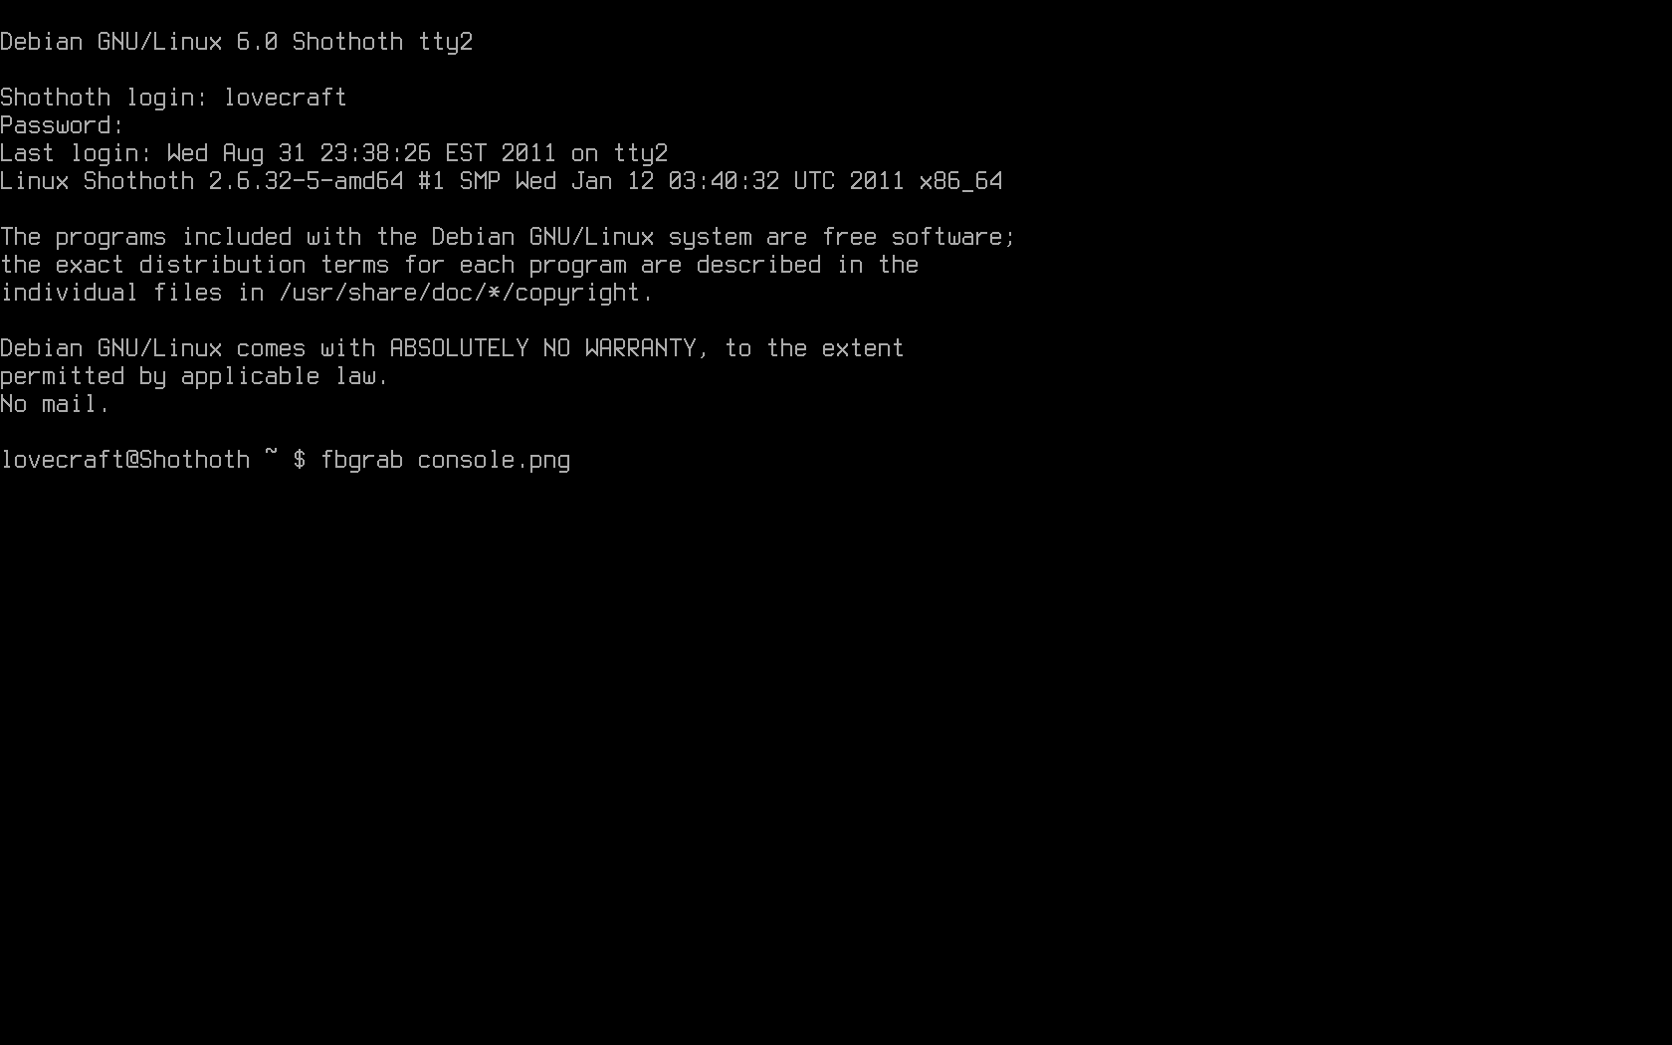

Slide 6
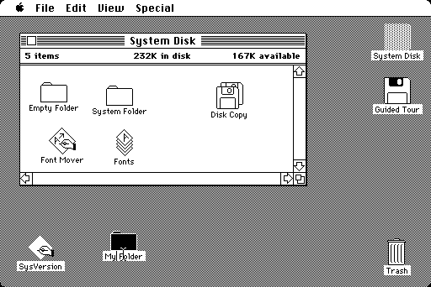

Slide 7
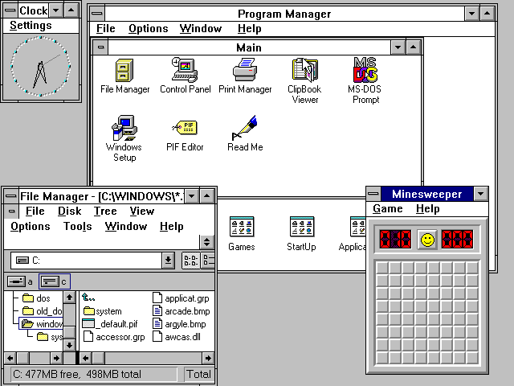
Notes:
Mention minesweeper, who played it?

Slide 8
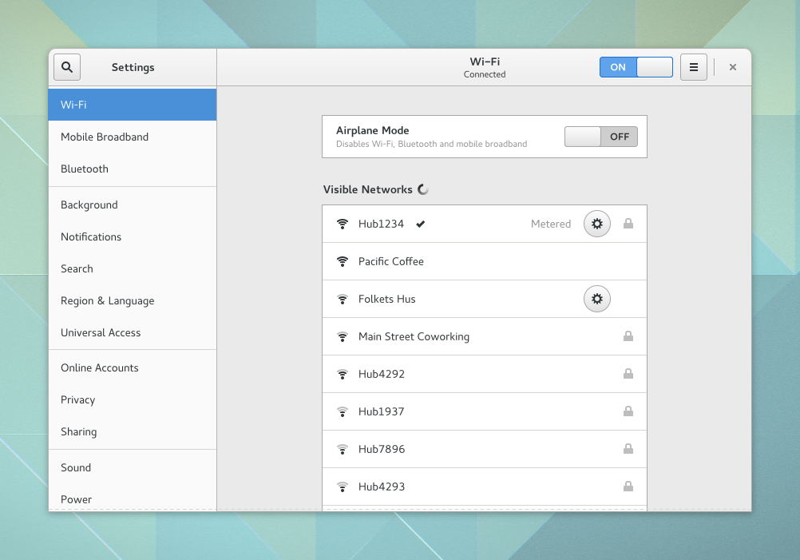

Slide 9
State of the art
WxWidgets
Gtk+, Qt
Android, Windows, Apple
Web based
Notes:
Ask how many people used one of those

Slide 10
Principles
Widgets & Containers
User input
Drawing
From code to display

Slide 11
Principles - Widgets & Containers
A widget is a UI Object
A widget can be a composition of other widgets
Containers layout the widgets
Box model vs Constraints

Slide 12
Principles - User input
Events
Callbacks

Slide 13
Principles - Drawing
2D graphics - Cairo
3D graphics - OpenGL
Stack awareness

Slide 14
Principles - From code to display
Root window
Buffer for drawing
Pixel cache and invalidation

Slide 15
Gtk
Brief history
Properties of the platform
Tooling

Slide 16
Gtk - Brief history
GIMP
It’s own library in 1998
A need from no free software GUI toolkits

Slide 17
Gtk - Properties of the platform
C based with GObject
Event driven
Multi platform
Multi language with GObject Introspection
2D graphics based (3D based since few weeks ago)
Single threaded

Slide 18
Gtk - Tooling
GNOME Builder as IDE
GtkInspector as interactive graphical debugger
DevHelp as documentation navigator
HIG as guidelines for a good GUI
Glade as GUI designer

Slide 19
“ Talk is cheap,
show me the code ”
Linus Torvalds

Slide 20
Phew, we’re finishing - Conclusions
Choose the right tool for you
Read docs, read code
Use the HIG
Make UI thread smooth

Slide 21
Resources
Gtk and HIG: https://developer.gnome.org
Help: irc.gnome.org #gtk+, Google+ GNOME
Code of this talk: https://github.com/csoriano89/gtklesson
Me: csoriano@gnome.org

Slide 22
Q&A we will know
What’s a GUI and why do we need it?
How can we do our own GUI app?
What resources can the toolkit offer us?
How can we make a good GUI, design wise?
How can we decide what are the right tool for me?
Where can we have further resources and help?

Slide 23
Thank you

